Slide 1
Lecture 5
Local Search
Yaohang Li
Department of Computer Science
ODU
Reading for Next Class:
Chapter 3, Russell and Norvig

Slide 2
Review
Last Class
  Informed Search
  Heuristic Functions
  A* Search
This Class
  Local Search
    Hill-Climbing
Next Class
  Evolutionary Computing

Slide 3
Local Search and Optimization Problems
The search algorithms we discussed before
  Goal
    Find the path to the goal that constitutes a solution to the problem
Many problems
  The path to the goal is irrelevant
  Another category of search problem
    Local Search Problem
      Never worry about the path
      Just want the goal
    Examples
      VLSI Design
      Factory-floor layout
      Automatic programming
      Telecommunications network optimization
      Protein folding

Slide 4
Local Search Algorithm
Objective (Fitness) Function f(x)
  All local search problems have an objective function to specify how “good” a state is
Strategy
  Keep only a single (complete) state in memory
  Generate only the neighbours of that state
  Keep one of the neighbours and discard others
Two key advantages
  Very little memory required
  Often find reasonable solutions in large or infinite state spaces
Usage
  Pure optimization problem
  Find the best state according to an objective function

Slide 5
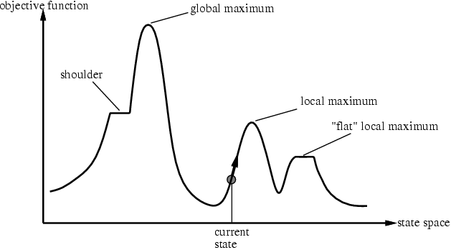
State Space Landscape
Global minimum
  The lowest valley
Global maximum
  The highest peak

Slide 6
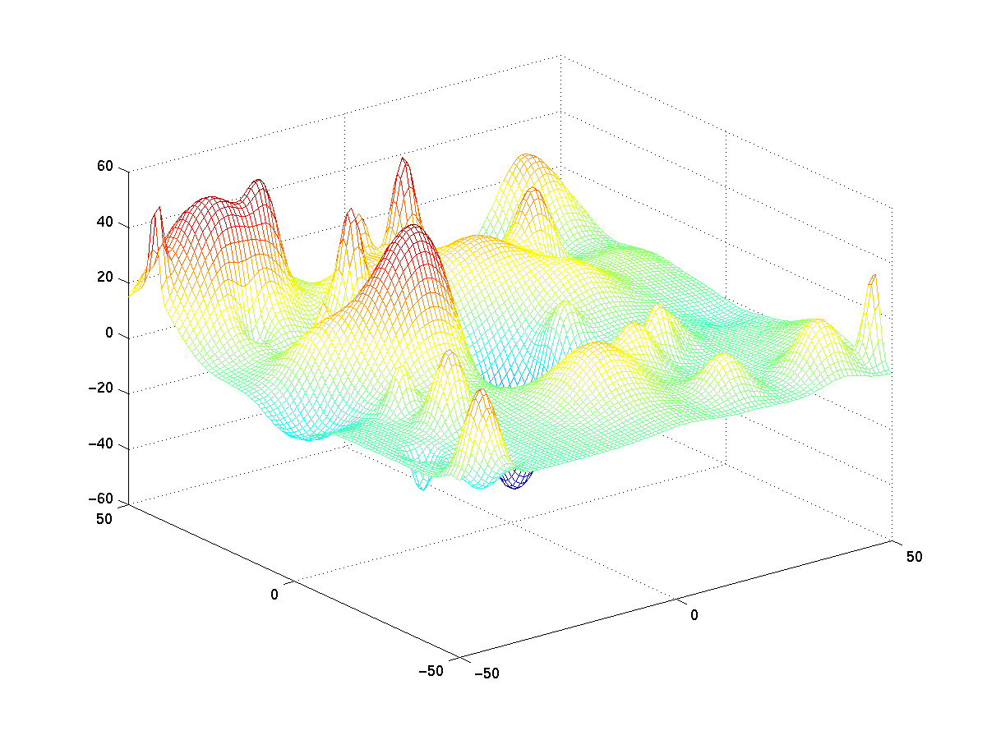
2-D State Space

Slide 7
Hill Climbing Algorithm
Moves
  Only permit to move to neighbors that improve f(x_{now})
Choice
  Choose x_{next}∈Neighbor(x_{now}) that f(x_{now})<f(x_{next})
Termination
  If no x_{next} can be found

Slide 8
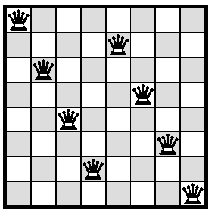
Hill-climbing: 8-Queens problem
Complete state formulation:
  All 8 queens on the board, one per column
  Neighbourhood: move one queen to a different place in the same column
  Fitness function: number of pairs of queens that are attacking each other

Slide 9
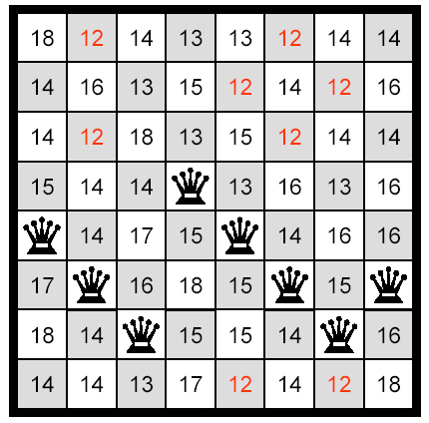
8-Queens problem: fitness values of neighbourhood

Slide 10
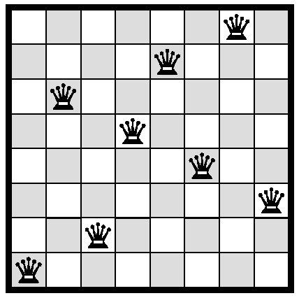
8-Queens problem:
Local minimum

Slide 11
Hill-Climbing
continually moves uphill
  increasing value of the evaluation function
  gradient descent search is a variation that moves downhill
very simple strategy with low space requirements
  stores only the state and its evaluation, no search tree
problems
  local maxima
    the peak is higher than all its neighbors, but not the global maximum
    algorithm can’t go higher, but is not at a satisfactory solution
  plateau
    area where the evaluation function is flat
  ridges
    search may oscillate slowly
    almost like a plateau

Slide 12
Performance of 8-Queens Problem
From randomly generated start state
Success rate:
  86% - gets stuck
  14% - solves problem

Slide 13
Further Variants of Hill Climbing
Stochastic hill-climbing:
  Choose at random from among uphill moves
First-choice hill-climbing:
  Generate neighbourhood in random order
  Move to first generated that represents an uphill move

Slide 14
Simulated annealing
Failing on neighbourhood search
  Propensity to deliver solutions which are only local optima
  Solutions depend on the initial solution
Reduce the chance of getting stuck in a local optimum by allowing moves to inferior solutions
Developed by Kirkpatrick 1983: Simulation of the cooling of material in a heat bath could be used to search the feasible solutions of an optimization problem
Notes:
Definir local optima
Mirar qué son Hill-climbing y Greedy

Slide 15



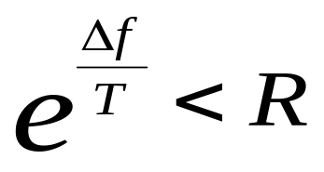
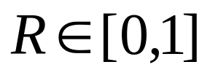
Simulated annealing
If a move from one solution to another neighbouring but inferior solution results in a change in value , the move to is still accepted if
T (temperature) – control parameter
– uniform random number

Slide 16
Simulated annealing: Intuition
Minimization problem; imagine a state space landscape on table
Let ping-pong ball from random point ➔ local minimum
Shake table ➔ball tends to find different minimum
Shake hard at first (high temperature) but gradually reduce intensity (lower temperature)

Slide 17


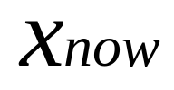
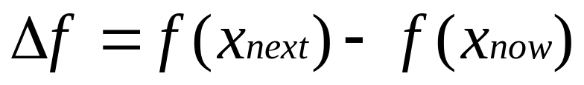
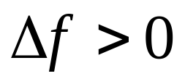

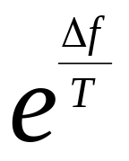
Simulated annealing: Algorithm
current = problem.initialState
for t=1 to
T = schedule(t)
if T=0 then return
= a random neighbour of
if then
else with probability

Slide 18
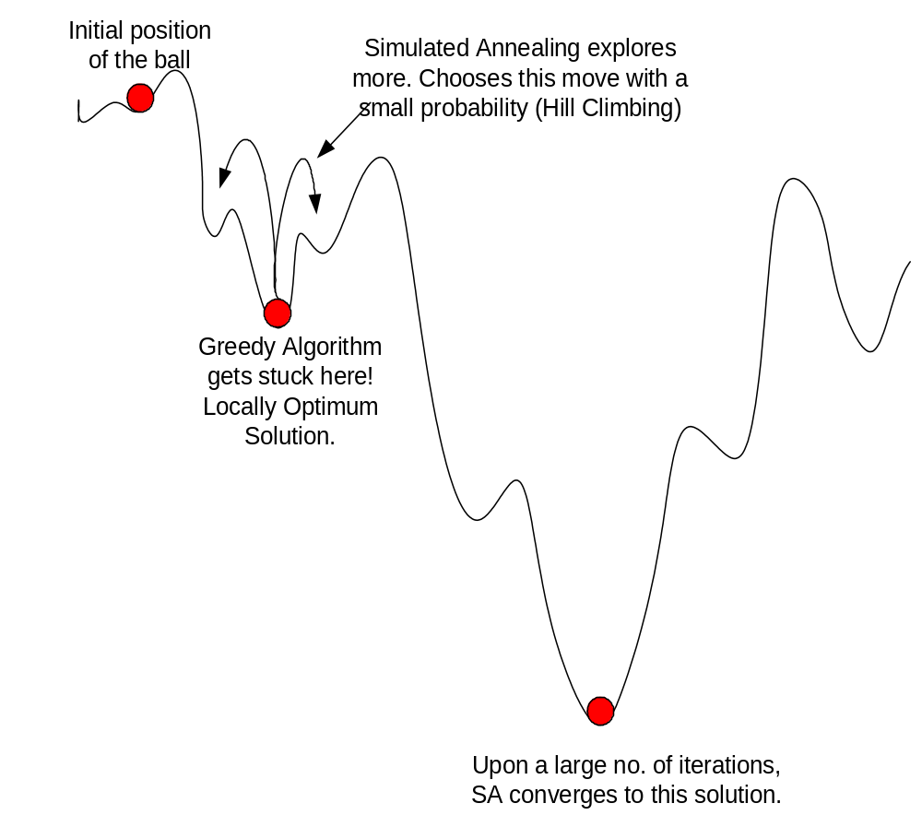
Ball on terrain example – SA vs Greedy Algorithms

Slide 19
Summary
Optimization
Local Search

Slide 20
What I want you to do
Review Chapter 3
Work on your assignment
Organize your project team

